Slide 1
Results Verification
Visualizations on Teaching Effectiveness
By: Louis Rosche

Slide 2
Abbreviation Keys
Summation Provided
All abbreviations are clarified in the speaker notes.
After the keys, a concise summary of effectiveness is provided.
Notes:
multi-objective optimization problem

Slide 3
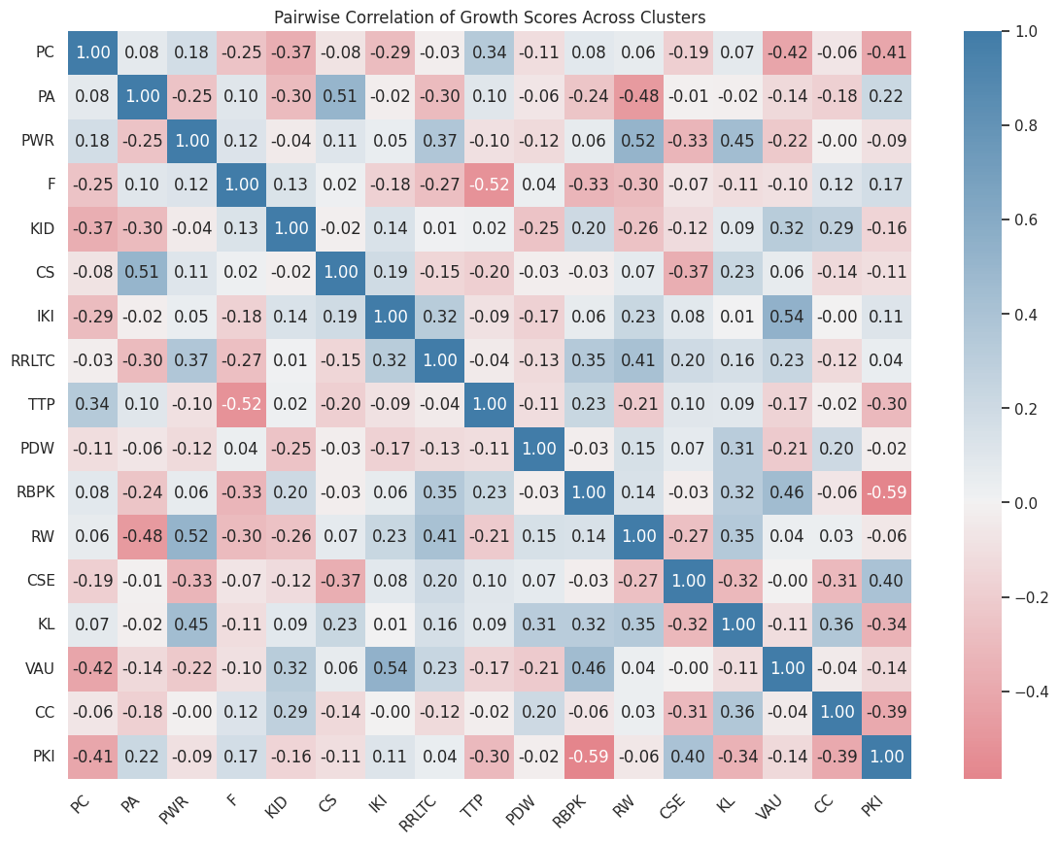
4th Grade, ELA Clusters, Year 1
Notes:
cluster_abbreviations = {
"Print Concepts": "PC",
"Phonological Awareness": "PA",
"Phonics and Word Recognition": "PWR",
"Fluency": "F",
"Key Ideas and Details": "KID",
"Craft and Structure": "CS",
"Integration of Knowledge and Ideas": "IKI",
"Range of Reading and Level of Text Complexity": "RRLTC",
"Text Types and Purposes": "TTP",
"Production and Distribution of Writing": "PDW",
"Research to Build and Present Knowledge": "RBPK",
"Range of Writing": "RW",
"Conventions of Standard English": "CSE",
"Knowledge of Language": "KL",
"Vocabulary Acquisition and Use": "VAU",
"Comprehension and Collaboration": "CC",
"Presentation of Knowledge and Ideas": "PKI"
}
The 'Pairwise Correlation of Growth Scores Across Clusters' heatmap uncovers complex relationships between the performance growth in different clusters. The varied correlation values underscore my strategic and adaptive teaching approach, which is finely attuned to the distinct dynamics of scholar performance within each cluster.

Slide 4
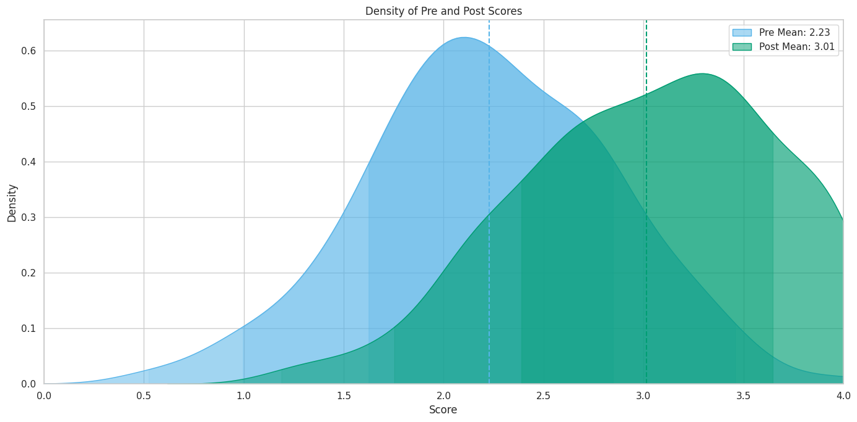
4th Grade, ELA Clusters, Year 1
Notes:
The 'Density of Pre and Post Scores' plot reveals a meaningful increase in scholars' performance, with the post-instruction scores not only surpassing pre-instruction scores on average but also exhibiting a denser concentration at the higher end of the scale, underscoring the positive impact of teaching practices.

Slide 5
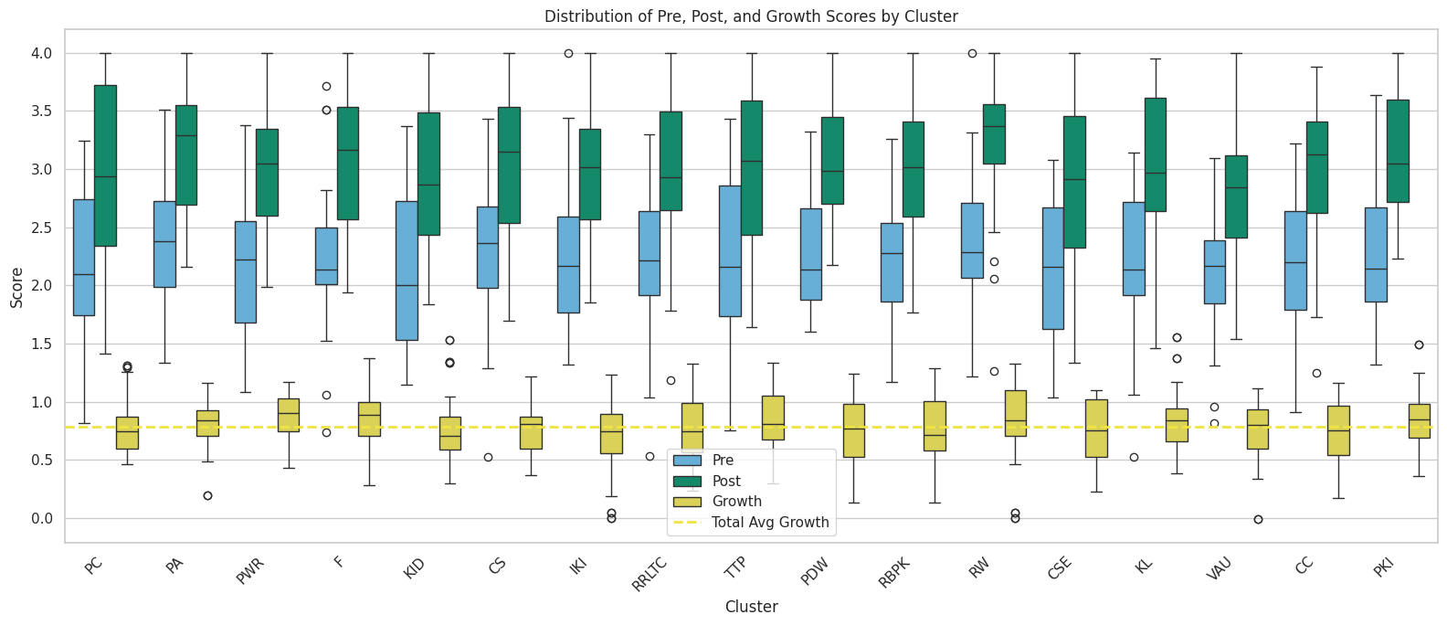
4th Grade, ELA Clusters, Year 1
Notes:
cluster_abbreviations = {
"Print Concepts": "PC",
"Phonological Awareness": "PA",
"Phonics and Word Recognition": "PWR",
"Fluency": "F",
"Key Ideas and Details": "KID",
"Craft and Structure": "CS",
"Integration of Knowledge and Ideas": "IKI",
"Range of Reading and Level of Text Complexity": "RRLTC",
"Text Types and Purposes": "TTP",
"Production and Distribution of Writing": "PDW",
"Research to Build and Present Knowledge": "RBPK",
"Range of Writing": "RW",
"Conventions of Standard English": "CSE",
"Knowledge of Language": "KL",
"Vocabulary Acquisition and Use": "VAU",
"Comprehension and Collaboration": "CC",
"Presentation of Knowledge and Ideas": "PKI"
}
In the 'Distribution of Pre, Post, and Growth Scores by Cluster' box plots, the shift in median scores and the interquartile range from pre to post evaluations reflect the depth and consistency of scholarly improvement under my guidance. The yellow growth boxes, aligned with the total average growth line, highlight the effectiveness of my tailored educational strategies across diverse learning groups.

Slide 6
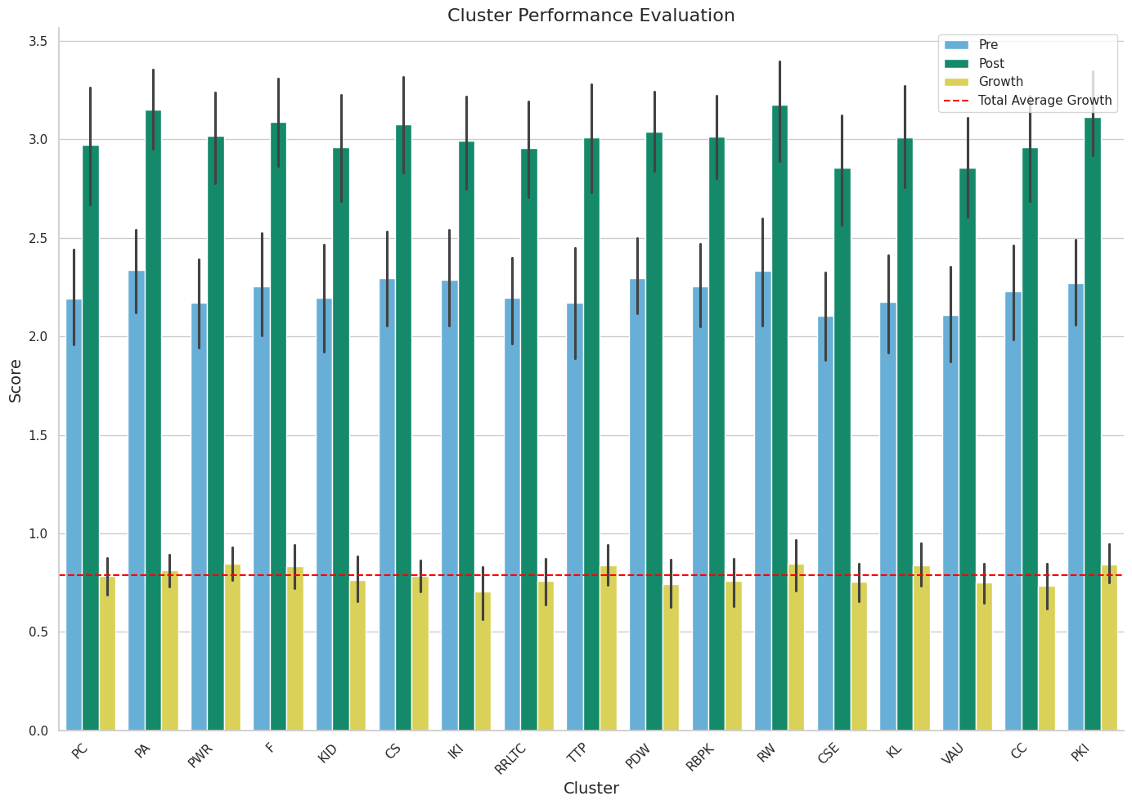
4th Grade, ELA Clusters, Year 1
Notes:
cluster_abbreviations = {
"Print Concepts": "PC",
"Phonological Awareness": "PA",
"Phonics and Word Recognition": "PWR",
"Fluency": "F",
"Key Ideas and Details": "KID",
"Craft and Structure": "CS",
"Integration of Knowledge and Ideas": "IKI",
"Range of Reading and Level of Text Complexity": "RRLTC",
"Text Types and Purposes": "TTP",
"Production and Distribution of Writing": "PDW",
"Research to Build and Present Knowledge": "RBPK",
"Range of Writing": "RW",
"Conventions of Standard English": "CSE",
"Knowledge of Language": "KL",
"Vocabulary Acquisition and Use": "VAU",
"Comprehension and Collaboration": "CC",
"Presentation of Knowledge and Ideas": "PKI"
}
The 'Cluster Performance Evaluation' chart exhibits a clear elevation in scholars' scores post my instructional period, with all clusters showing growth above the total average growth benchmark. This data is a robust indicator of my ability to significantly improve academic outcomes.

Slide 7
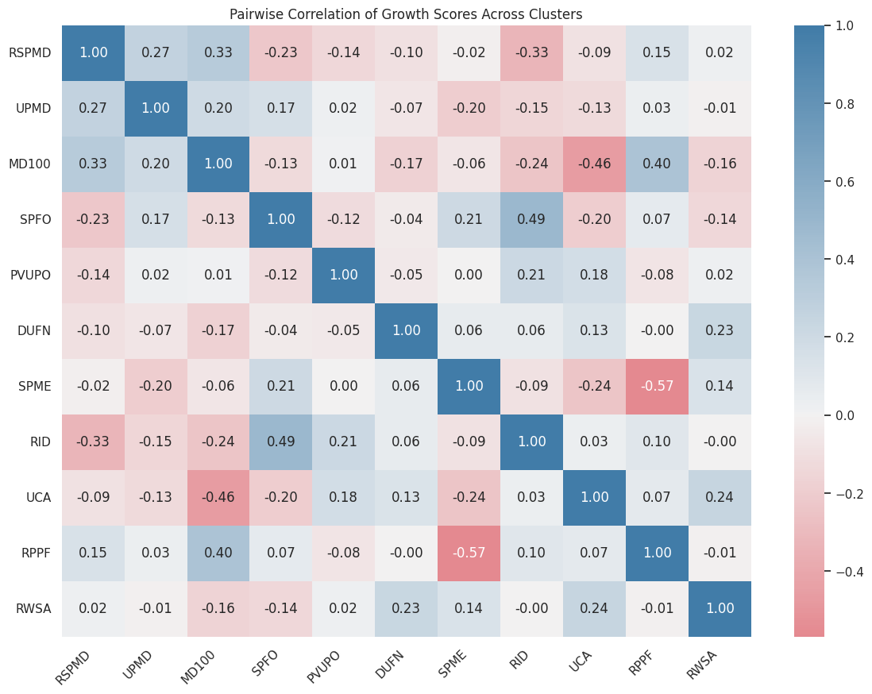
3rd Grade, Math Clusters, Year 2
Notes:
cluster_abbreviations = {
'Represent and solve problems involving multiplication and division': 'RSPMD',
'Understand properties of multiplication and the relationship between multiplication and division': 'UPMD',
'Multiply and divide within 100': 'MD100',
'Solve problems involving the four operations, and identify and explain patterns in arithmetic': 'SPFO',
'Use place value understanding and properties of operations to perform multi-digit arithmetic': 'PVUPO',
'Develop understanding of fractions as numbers': 'DUFN',
'Solve problems involving measurement and estimation': 'SPME',
'Represent and interpret data': 'RID',
'Understand concepts of area and relate area to multiplication and to addition': 'UCA',
'Recognize perimeter as an attribute of plane figures and distinguish between linear and area measures': 'RPPF',
'Reason with shapes and their attributes': 'RWSA'
}
The 'Pairwise Correlation of Growth Scores Across Clusters' heatmap reveals the intricate relationships between different clusters' growth patterns. My strategic pedagogical adjustments are informed by these correlations, ensuring that my teaching methods are both responsive and impactful across various learning groups.

Slide 8
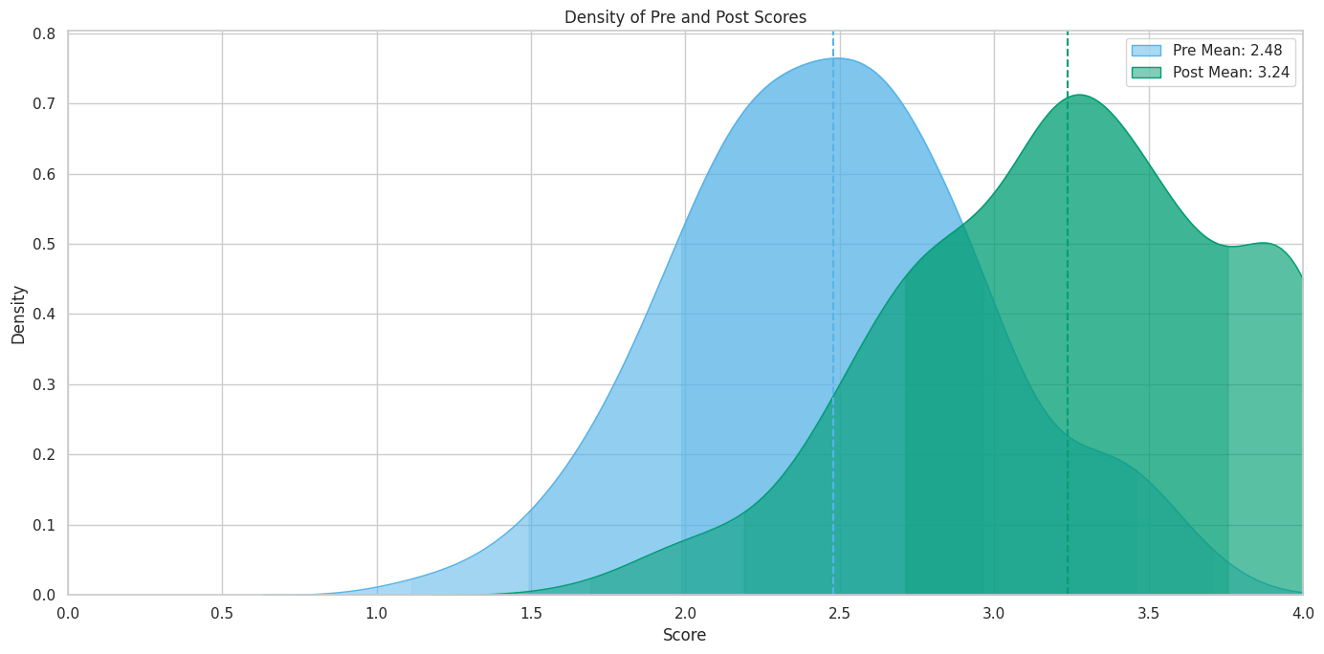
3rd Grade, Math Clusters, Year 2
Notes:
The 'Density of Pre and Post Scores' graph demonstrates a notable shift towards higher scores post-instruction. My teaching has not only raised the average but has also redefined the standard deviation, signifying a comprehensive elevation in the scholars' mastery of the content.

Slide 9
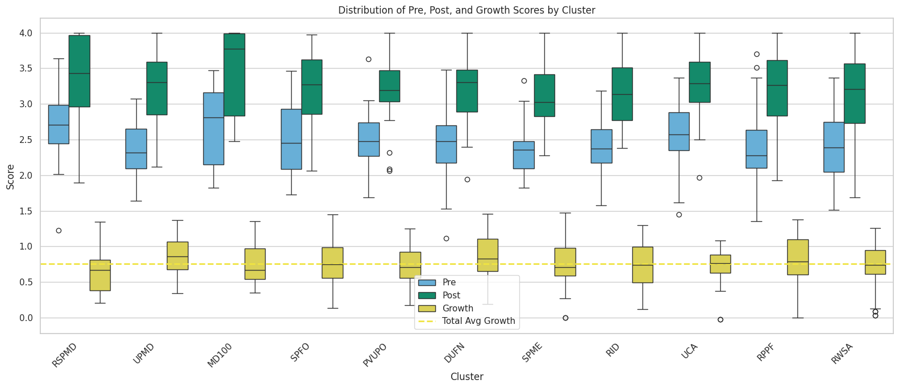
3rd Grade, Math Clusters, Year 2
Notes:
cluster_abbreviations = {
'Represent and solve problems involving multiplication and division': 'RSPMD',
'Understand properties of multiplication and the relationship between multiplication and division': 'UPMD',
'Multiply and divide within 100': 'MD100',
'Solve problems involving the four operations, and identify and explain patterns in arithmetic': 'SPFO',
'Use place value understanding and properties of operations to perform multi-digit arithmetic': 'PVUPO',
'Develop understanding of fractions as numbers': 'DUFN',
'Solve problems involving measurement and estimation': 'SPME',
'Represent and interpret data': 'RID',
'Understand concepts of area and relate area to multiplication and to addition': 'UCA',
'Recognize perimeter as an attribute of plane figures and distinguish between linear and area measures': 'RPPF',
'Reason with shapes and their attributes': 'RWSA'
}
Examining the 'Distribution of Pre, Post, and Growth Scores by Cluster' box plots, the breadth of score distribution highlights my ability to elevate the median understanding of the subject matter. Even with the presence of outliers, my teaching has consistently yielded positive growth, indicating a tailored approach that accounts for the diversity of scholar aptitudes.

Slide 10
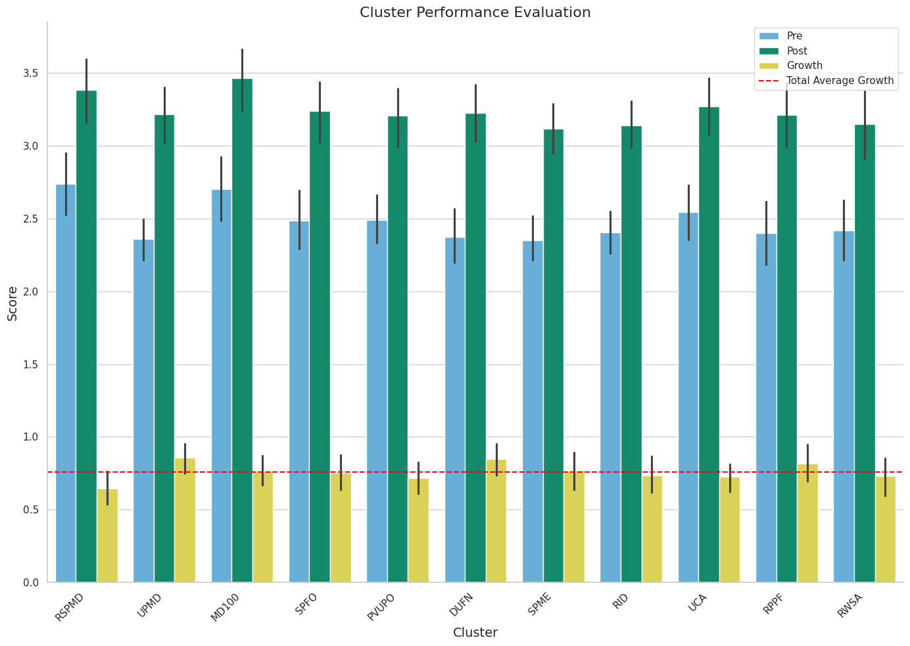
3rd Grade, Math Clusters, Year 2
Notes:
cluster_abbreviations = {
'Represent and solve problems involving multiplication and division': 'RSPMD',
'Understand properties of multiplication and the relationship between multiplication and division': 'UPMD',
'Multiply and divide within 100': 'MD100',
'Solve problems involving the four operations, and identify and explain patterns in arithmetic': 'SPFO',
'Use place value understanding and properties of operations to perform multi-digit arithmetic': 'PVUPO',
'Develop understanding of fractions as numbers': 'DUFN',
'Solve problems involving measurement and estimation': 'SPME',
'Represent and interpret data': 'RID',
'Understand concepts of area and relate area to multiplication and to addition': 'UCA',
'Recognize perimeter as an attribute of plane figures and distinguish between linear and area measures': 'RPPF',
'Reason with shapes and their attributes': 'RWSA'
}
In the 'Cluster Performance Evaluation' chart, the data reflects a significant improvement in scholars' scores from pre to post assessments across all clusters. My teaching methods are quantitatively validated here, showcasing that my approach effectively enhances academic performance.

Slide 11
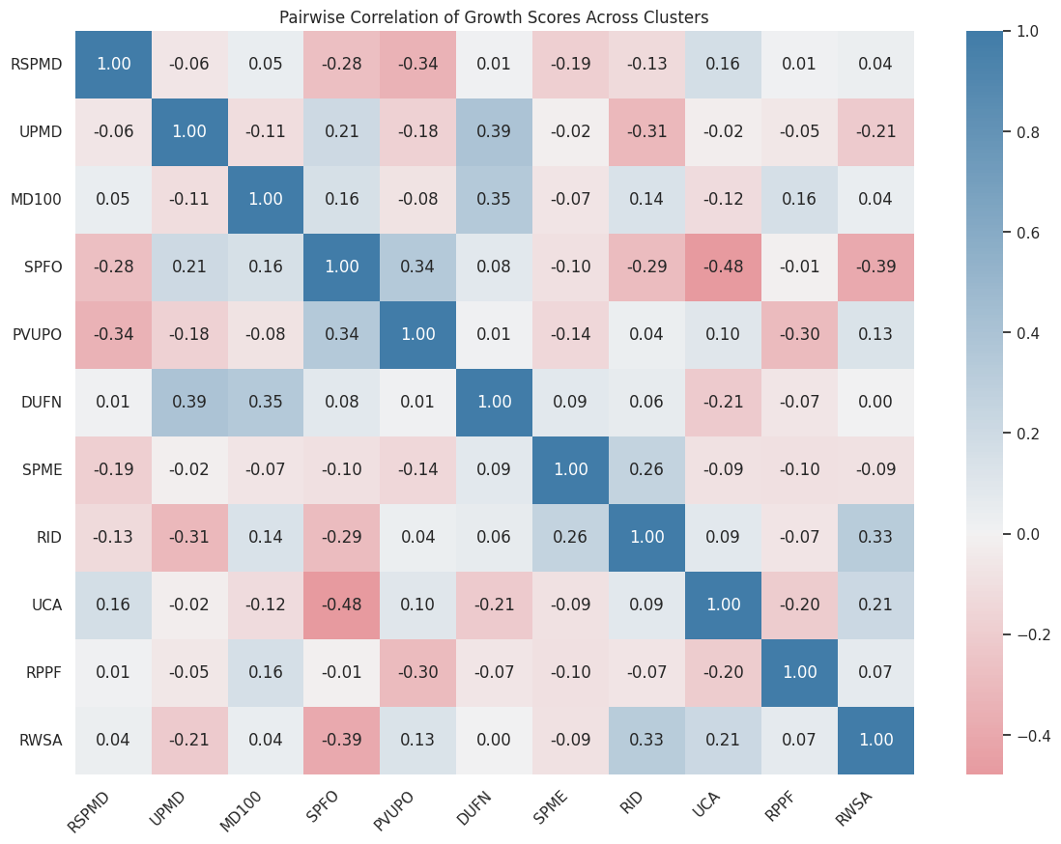
3rd Grade, Math Clusters, Year 3
Notes:
cluster_abbreviations = {
'Represent and solve problems involving multiplication and division': 'RSPMD',
'Understand properties of multiplication and the relationship between multiplication and division': 'UPMD',
'Multiply and divide within 100': 'MD100',
'Solve problems involving the four operations, and identify and explain patterns in arithmetic': 'SPFO',
'Use place value understanding and properties of operations to perform multi-digit arithmetic': 'PVUPO',
'Develop understanding of fractions as numbers': 'DUFN',
'Solve problems involving measurement and estimation': 'SPME',
'Represent and interpret data': 'RID',
'Understand concepts of area and relate area to multiplication and to addition': 'UCA',
'Recognize perimeter as an attribute of plane figures and distinguish between linear and area measures': 'RPPF',
'Reason with shapes and their attributes': 'RWSA'
}
The 'Pairwise Correlation of Growth Scores Across Clusters' heatmap provides an intricate look at the relationships between clusters. The varying correlation coefficients show that the growth in scholar performance is not uniform across all clusters, which highlights the customized approach I've taken in my instruction to cater to the diverse needs of each group of scholars.

Slide 12
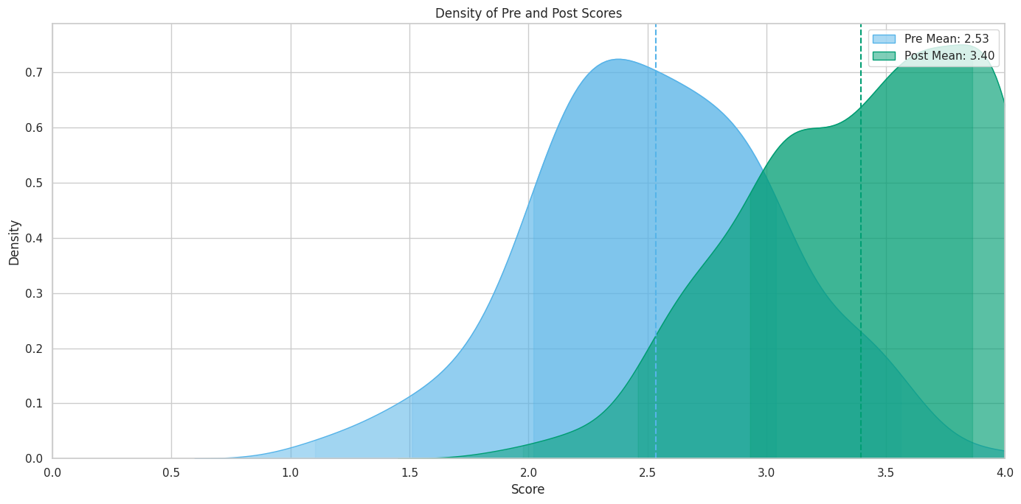
3rd Grade, Math Clusters, Year 3
Notes:
In the 'Density of Pre and Post Scores' visualization, we see a distinct rightward shift and a higher peak in the Post scores. This visual representation indicates a substantial improvement in scores under my instruction, with a greater density of scholars achieving higher scores, effectively demonstrating the overarching impact of my teaching strategies.

Slide 13
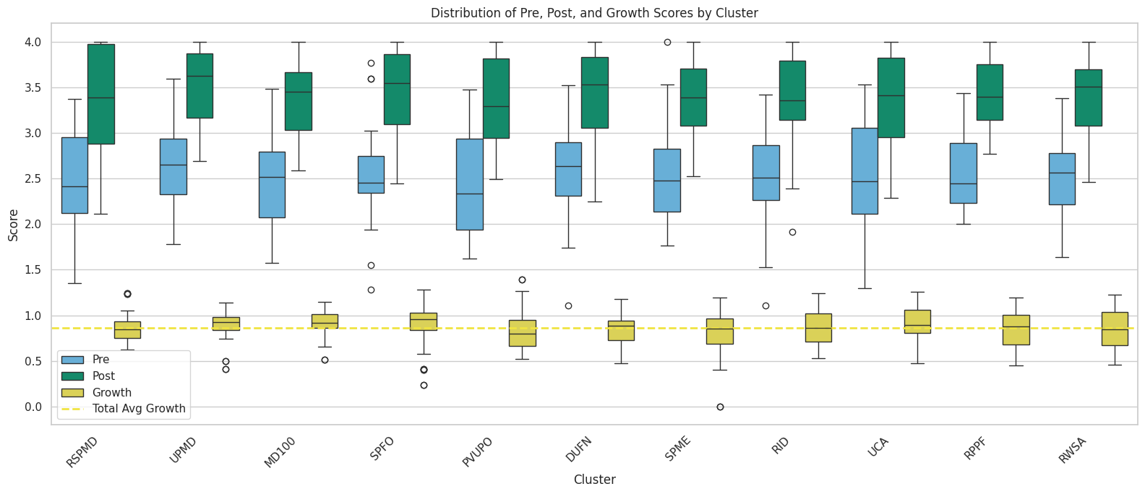
3rd Grade, Math Clusters, Year 3
Notes:
cluster_abbreviations = {
'Represent and solve problems involving multiplication and division': 'RSPMD',
'Understand properties of multiplication and the relationship between multiplication and division': 'UPMD',
'Multiply and divide within 100': 'MD100',
'Solve problems involving the four operations, and identify and explain patterns in arithmetic': 'SPFO',
'Use place value understanding and properties of operations to perform multi-digit arithmetic': 'PVUPO',
'Develop understanding of fractions as numbers': 'DUFN',
'Solve problems involving measurement and estimation': 'SPME',
'Represent and interpret data': 'RID',
'Understand concepts of area and relate area to multiplication and to addition': 'UCA',
'Recognize perimeter as an attribute of plane figures and distinguish between linear and area measures': 'RPPF',
'Reason with shapes and their attributes': 'RWSA'
}
The 'Distribution of Pre, Post, and Growth Scores by Cluster' box plots offer a deeper insight into the score distributions, revealing not only a consistent upward shift in medians from Pre to Post but also a decrease in interquartile ranges post-intervention. This suggests a tightening of scores around a higher median, indicative of my ability to elevate and standardize scholars' understanding of the curriculum.

Slide 14
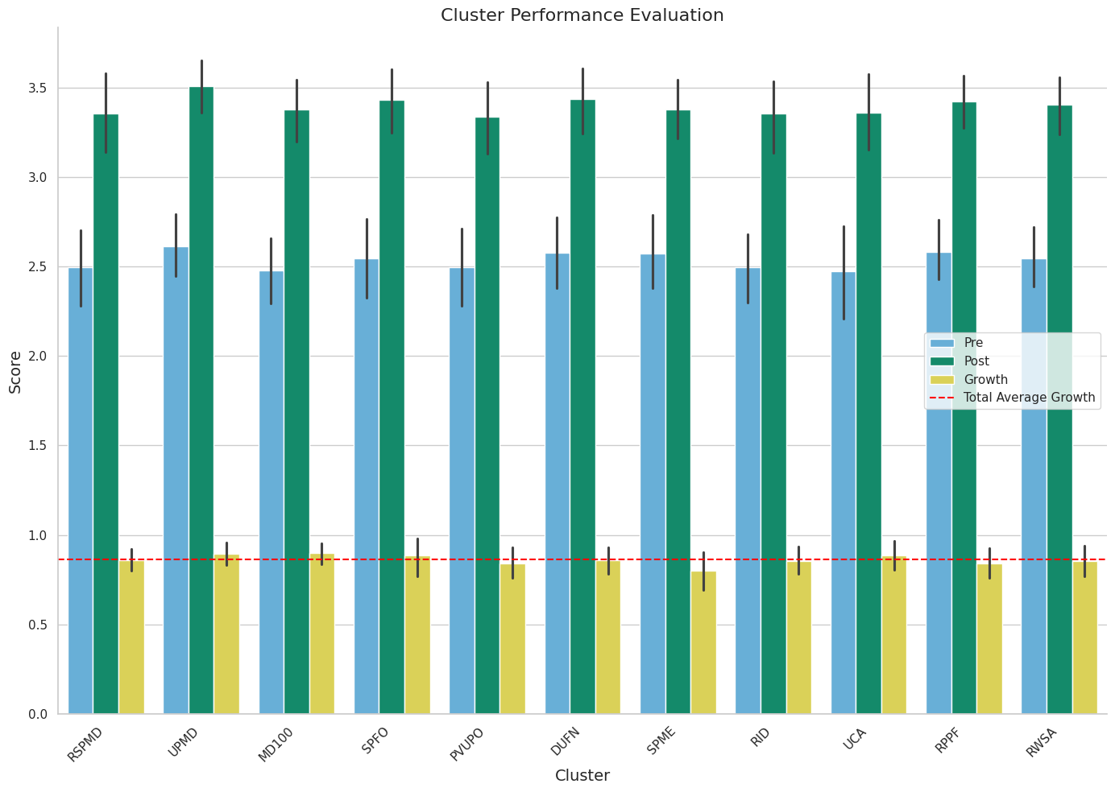
3rd Grade, Math Clusters, Year 3
Notes:
cluster_abbreviations = {
'Represent and solve problems involving multiplication and division': 'RSPMD',
'Understand properties of multiplication and the relationship between multiplication and division': 'UPMD',
'Multiply and divide within 100': 'MD100',
'Solve problems involving the four operations, and identify and explain patterns in arithmetic': 'SPFO',
'Use place value understanding and properties of operations to perform multi-digit arithmetic': 'PVUPO',
'Develop understanding of fractions as numbers': 'DUFN',
'Solve problems involving measurement and estimation': 'SPME',
'Represent and interpret data': 'RID',
'Understand concepts of area and relate area to multiplication and to addition': 'UCA',
'Recognize perimeter as an attribute of plane figures and distinguish between linear and area measures': 'RPPF',
'Reason with shapes and their attributes': 'RWSA'
}
The 'Cluster Performance Evaluation' graph shows the rise in scores from the Pre to Post phase across all clusters and demonstrates my effective teaching methods. The fact that each cluster shows positive growth, with most exceeding the total average growth line, indicates that the utilized educational strategies are producing a significant increase in scholarly performance.

